Slide 1
KRYPTOS
Patrick Kellogg
patrickkellogg@gmail.com
http://www.patrickkellogg.com/kryptos

Slide 2
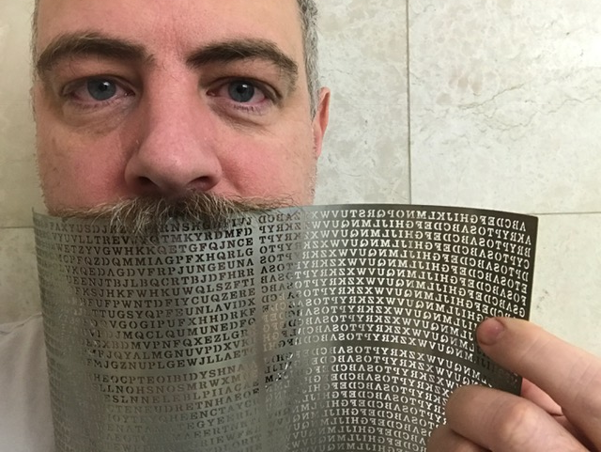
I love this sculpture by Jim Sanborn
(Note: tiny reproduction)

Slide 3
About Kryptos
The sculpture was erected in 1990 on the grounds of the CIA headquarters in Langley, Virginia
The main part of the sculpture is a curved metal wall standing about 12 feet high
There are also several benches, a fish pond, a magnetic lodestone, a compass, and many copper plates embossed with Morse code
Sanborn worked with NSA cryptographer Ed Scheidt to understand the algorithms used

Slide 4
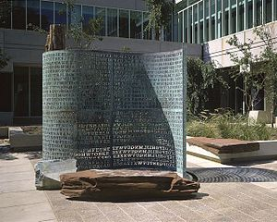
(Note: not my photo. This is from Wikipedia, and taken was provided by the artist Jim Sanborn)

Slide 5
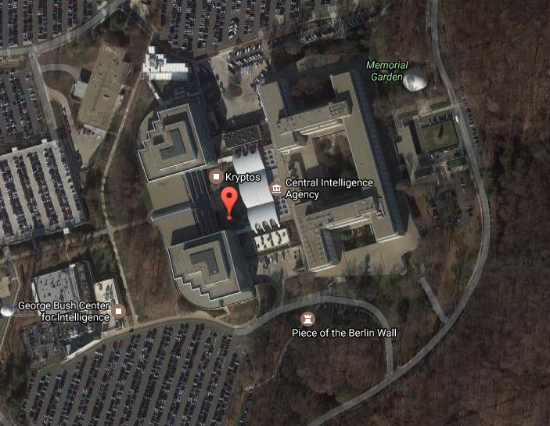
Arial map from Google Earth

Slide 6
The sculpture has encrypted text on the left side, and a Vigenère table on the right
EMUFPHZLRFAXYUSDJKZLDKRNSHGNFIVJ YQTQUXQBQVYUVLLTREVJYQTMKYRDMFD VFPJUDEEHZWETZYVGWHKKQETGFQJNCE GGWHKK?DQMCPFQZDQMMIAGPFXHQRLG TIMVMZJANQLVKQEDAGDVFRPJUNGEUNA QZGZLECGYUXUEENJTBJLBQCRTBJDFHRR YIZETKZEMVDUFKSJHKFWHKUWQLSZFTI HHDDDUVH?DWKBFUFPWNTDFIYCUQZERE EVLDKFEZMOQQJLTTUGSYQPFEUNLAVIDX FLGGTEZ?FKZBSFDQVGOGIPUFXHHDRKF FHQNTGPUAECNUVPDJMQCLQUMUNEDFQ ELZZVRRGKFFVOEEXBDMVPNFQXEZLGRE DNQFMPNZGLFLPMRJQYALMGNUVPDXVKP DQUMEBEDMHDAFMJGZNUPLGEWJLLAETG | ABCDEFGHIJKLMNOPQRSTUVWXYZABCD AKRYPTOSABCDEFGHIJLMNQUVWXZKRYP BRYPTOSABCDEFGHIJLMNQUVWXZKRYPT CYPTOSABCDEFGHIJLMNQUVWXZKRYPTO DPTOSABCDEFGHIJLMNQUVWXZKRYPTOS ETOSABCDEFGHIJLMNQUVWXZKRYPTOSA FOSABCDEFGHIJLMNQUVWXZKRYPTOSAB GSABCDEFGHIJLMNQUVWXZKRYPTOSABC HABCDEFGHIJLMNQUVWXZKRYPTOSABCD IBCDEFGHIJLMNQUVWXZKRYPTOSABCDE JCDEFGHIJLMNQUVWXZKRYPTOSABCDEF KDEFGHIJLMNQUVWXZKRYPTOSABCDEFG LEFGHIJLMNQUVWXZKRYPTOSABCDEFGH MFGHIJLMNQUVWXZKRYPTOSABCDEFGHI
ENDYAHROHNLSRHEOCPTEOIBIDYSHNAIA CHTNREYULDSLLSLLNOHSNOSMRWXMNE TPRNGATIHNRARPESLNNELEBLPIIACAE WMTWNDITEENRAHCTENEUDRETNHAEOE TFOLSEDTIWENHAEIOYTEYQHEENCTAYCR EIFTBRSPAMHHEWENATAMATEGYEERLB TEEFOASFIOTUETUAEOTOARMAEERTNRTI BSEDDNIAAHTTMSTEWPIEROAGRIEWFEB AECTDDHILCEIHSITEGOEAOSDDRYDLORIT RKLMLEHAGTDHARDPNEOHMGFMFEUHE ECDMRIPFEIMEHNLSSTTRTVDOHW?OBKR UOXOGHULBSOLIFBBWFLRVQQPRNGKSSO TWTQSJQSSEKZZWATJKLUDIAWINFBNYP VTTMZFPKWGDKZXTJCDIGKUHUAUEKCAR | NGHIJLMNQUVWXZKRYPTOSABCDEFGHIJL OHIJLMNQUVWXZKRYPTOSABCDEFGHIJL PIJLMNQUVWXZKRYPTOSABCDEFGHIJLM QJLMNQUVWXZKRYPTOSABCDEFGHIJLMN RLMNQUVWXZKRYPTOSABCDEFGHIJLMNQ SMNQUVWXZKRYPTOSABCDEFGHIJLMNQU TNQUVWXZKRYPTOSABCDEFGHIJLMNQUV UQUVWXZKRYPTOSABCDEFGHIJLMNQUVW VUVWXZKRYPTOSABCDEFGHIJLMNQUVWX WVWXZKRYPTOSABCDEFGHIJLMNQUVWXZ XWXZKRYPTOSABCDEFGHIJLMNQUVWXZK YXZKRYPTOSABCDEFGHIJLMNQUVWXZKR ZZKRYPTOSABCDEFGHIJLMNQUVWXZKRY ABCDEFGHIJKLMNOPQRSTUVWXYZABCD

Slide 7
There are actually four separate encrypted parts: the first three have been solved
EMUFPHZLRFAXYUSDJKZLDKRNSHGNFIVJ YQTQUXQBQVYUVLLTREVJYQTMKYRDMFD VFPJUDEEHZWETZYVGWHKKQETGFQJNCE GGWHKK?DQMCPFQZDQMMIAGPFXHQRLG TIMVMZJANQLVKQEDAGDVFRPJUNGEUNA QZGZLECGYUXUEENJTBJLBQCRTBJDFHRR YIZETKZEMVDUFKSJHKFWHKUWQLSZFTI HHDDDUVH?DWKBFUFPWNTDFIYCUQZERE EVLDKFEZMOQQJLTTUGSYQPFEUNLAVIDX FLGGTEZ?FKZBSFDQVGOGIPUFXHHDRKF FHQNTGPUAECNUVPDJMQCLQUMUNEDFQ ELZZVRRGKFFVOEEXBDMVPNFQXEZLGRE DNQFMPNZGLFLPMRJQYALMGNUVPDXVKP DQUMEBEDMHDAFMJGZNUPLGEWJLLAETG | ABCDEFGHIJKLMNOPQRSTUVWXYZABCD AKRYPTOSABCDEFGHIJLMNQUVWXZKRYP BRYPTOSABCDEFGHIJLMNQUVWXZKRYPT CYPTOSABCDEFGHIJLMNQUVWXZKRYPTO DPTOSABCDEFGHIJLMNQUVWXZKRYPTOS ETOSABCDEFGHIJLMNQUVWXZKRYPTOSA FOSABCDEFGHIJLMNQUVWXZKRYPTOSAB GSABCDEFGHIJLMNQUVWXZKRYPTOSABC HABCDEFGHIJLMNQUVWXZKRYPTOSABCD IBCDEFGHIJLMNQUVWXZKRYPTOSABCDE JCDEFGHIJLMNQUVWXZKRYPTOSABCDEF KDEFGHIJLMNQUVWXZKRYPTOSABCDEFG LEFGHIJLMNQUVWXZKRYPTOSABCDEFGH MFGHIJLMNQUVWXZKRYPTOSABCDEFGHI
ENDYAHROHNLSRHEOCPTEOIBIDYSHNAIA CHTNREYULDSLLSLLNOHSNOSMRWXMNE TPRNGATIHNRARPESLNNELEBLPIIACAE WMTWNDITEENRAHCTENEUDRETNHAEOE TFOLSEDTIWENHAEIOYTEYQHEENCTAYCR EIFTBRSPAMHHEWENATAMATEGYEERLB TEEFOASFIOTUETUAEOTOARMAEERTNRTI BSEDDNIAAHTTMSTEWPIEROAGRIEWFEB AECTDDHILCEIHSITEGOEAOSDDRYDLORIT RKLMLEHAGTDHARDPNEOHMGFMFEUHE ECDMRIPFEIMEHNLSSTTRTVDOHW?OBKR UOXOGHULBSOLIFBBWFLRVQQPRNGKSSO TWTQSJQSSEKZZWATJKLUDIAWINFBNYP VTTMZFPKWGDKZXTJCDIGKUHUAUEKCAR | NGHIJLMNQUVWXZKRYPTOSABCDEFGHIJL OHIJLMNQUVWXZKRYPTOSABCDEFGHIJL PIJLMNQUVWXZKRYPTOSABCDEFGHIJLM QJLMNQUVWXZKRYPTOSABCDEFGHIJLMN RLMNQUVWXZKRYPTOSABCDEFGHIJLMNQ SMNQUVWXZKRYPTOSABCDEFGHIJLMNQU TNQUVWXZKRYPTOSABCDEFGHIJLMNQUV UQUVWXZKRYPTOSABCDEFGHIJLMNQUVW VUVWXZKRYPTOSABCDEFGHIJLMNQUVWX WVWXZKRYPTOSABCDEFGHIJLMNQUVWXZ XWXZKRYPTOSABCDEFGHIJLMNQUVWXZK YXZKRYPTOSABCDEFGHIJLMNQUVWXZKR ZZKRYPTOSABCDEFGHIJLMNQUVWXZKRY ABCDEFGHIJKLMNOPQRSTUVWXYZABCD

Slide 8
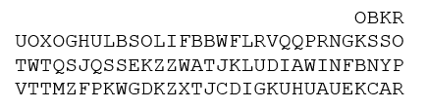
The fourth part is still unencrypted! Despite many attempts over the last 25 years, no one knows what the last part of the message means, or if it ties the message of the whole sculpture together.

Slide 9
K1 Information
The four parts of the sculpture have been referred to as K1, K2, K3, and K4
K1 and K2 were first solved publicly in 1999 by computer scientist Jim Gillogly
(Though supposedly the NSA solved it in three days)

Slide 10
K1 Solution
K1 is a simple Vigenère substitution
The keyword for K1 is PALIMPSEST
And the plaintext for K1 turns out to be:
BETWEEN SUBTLE SHADING AND THE ABSENCE OF LIGHT LIES THE NUANCE OF IQLUSION

Slide 11
Weird Things About K1
Sanborn intentionally misspelled the word “IQLUSION”, which is a traditional method of making decryption more difficult
The word “PALIMPSEST” means “a manuscript page, either from a scroll or a book, from which the text has been scraped or washed off so that the page can be reused for another document”, which may have artistic meaning for the artist

Slide 12
More Weird Things About K1
Note that the Vigenère used to solve K1 is not the one on the right side of the sculpture!
Instead, Sanborn uses a variant of Vigenère called a “Quagmire III” which requires both an “Alphabet Key” at the top of the table, and a repeated “Passphrase”
  Alphabet key = KRYPTOS
  Passphrase = PALIMPSEST

Slide 13

Setting Up The Quagmire III
First, take the standard alphabet and pull the non-repeating letters of the Alphabet Key out and stick them at the front
KRYPTOSABCDEFGHIJLMNQUVWXZ
Then, add rows corresponding with the Passphrase. For example, the first “P” row starts with “PTOSABC…”

Slide 14
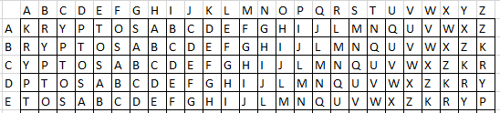
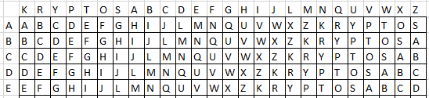
Warning: Actually Not A Vigenère
However, Sanborn does something strange
On the sculpture, he depicts a standard table. However, that is not the table he uses!
First lines on the sculpture ↑
Actual substitution table ↑

Slide 15
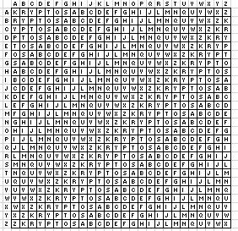
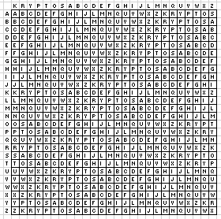
“Sanborn” Vigenère Vs. Quagmire III
Both the column order AND the row orders are different. This will give you incorrect results if you try to use a traditional method!
Standard Vigenère Sanborn’s Table

Slide 16
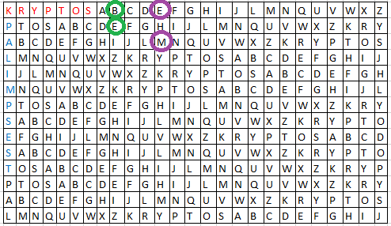
Let’s Solve K1!
EMUFPHZLRFAXYUSDJKZLDKRNSHGNFIVJ YQTQUXQBQVYUVLLTREVJYQTMKYRDMFD
So, the first two decrypted letters are “BE”
The next are “TWEE”

Slide 17
More About K1
BETWEEN SUBTLE SHADING AND THE ABSENCE OF LIGHT LIES THE NUANCE OF IQLUSION
This is a poetic phrase made up by Jim Sanborn
Maybe it refers to the nearby sundial?
  Or perhaps Sanborn is talking about the way the sun shines THROUGH the cut-out letters of the sculpture to cast a message on the world below

Slide 18
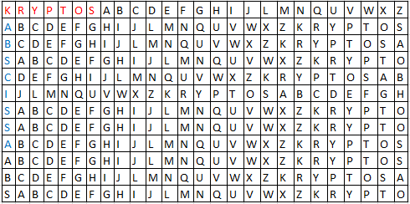
Let’s Solve K2!
K2 was solved similarly using the keyword
ABSCISSA

Slide 19
Let’s Solve K2!
The decrypted message is:
IT WAS TOTALLY INVISIBLE HOWS THAT POSSIBLE ? THEY USED THE EARTHS MAGNETIC FIELD X THE INFORMATION WAS GATHERED AND TRANSMITTED UNDERGRUUND TO AN UNKNOWN LOCATION X DOES LANGLEY KNOW ABOUT THIS ? THEY SHOULD ITS BURIED OUT THERE SOMEWHERE X WHO KNOWS THE EXACT LOCATION ? ONLY WW THIS WAS HIS LAST MESSAGE X THIRTY EIGHT DEGREES FIFTY SEVEN MINUTES SIX POINT FIVE SECONDS NORTH SEVENTY SEVEN DEGREES EIGHT MINUTES FORTY FOUR SECONDS WEST X LAYER TWO

Slide 20
K2 Meaning
This is another original message by Sanborn
The geographic coordinates mentioned in the message correspond roughly to the location of the sculpture itself (about 100 feet southeast)
No, the CIA won’t let you into the courtyard in order to dig around to see what you find

Slide 21
Weird things about K2
Again, there is a misspelled word (UNDERGRUUND)
In addition, K2 is the only part of the sculpture that contains punctuation (i.e. question marks). Traditionally, these are taken out before encryption

Slide 22
“Who is WW?”
“WW” stands for William Webster, who was the Director of the CIA at the time that Kryptos was installed
At the 1990 dedication ceremony of Kryptos, Sanborn gave a sealed envelope to Webster, which reportedly contained the solution
However, in a 2005 interview with Wired magazine, Sanborn said that Scheidt and Webster only thought they knew the solution. In fact, he had deceived them.

Slide 23
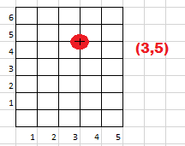
More About K2
The word “ABSCISSA” means:
  the number whose absolute value (modulus) is the perpendicular distance of a point from the vertical axis
  For example, below the “abscissa” is 3 and the “ordinate” is 5
Maybe, like PALIMPSEST, this word has special meaning to the artist

Slide 24
Huge Mistake In K2
The first people to solve K2 decrypted the final line to be: “...FOUR SECONDS WEST ID BY ROWS”
However, this was wrong. It should have been “...FOUR SECONDS WEST X LAYER TWO”
Sanborn made a terrible mistake when manufacturing the sculpture. He took the line
…PLGEXWJLLAETG
and bizarrely removed the the “X” thinking it was not needed. Of course, this dramatically changes the plaintext. If you randomly delete a letter in an encrypted Vigenère, all letters after it will be incorrect. It’s amazing that the rest of the message after the X made any sense!

Slide 25
K3
The third part of the sculpture is completely different! Unlike K1 and K3, it is not a Vigenère (nor a Quagmire III)
Instead, the letters are rearranged according to a Transposition Cypher. No letter substitution is performed… a “Q” in the cypher is a “Q” in the plaintext forever

Slide 26
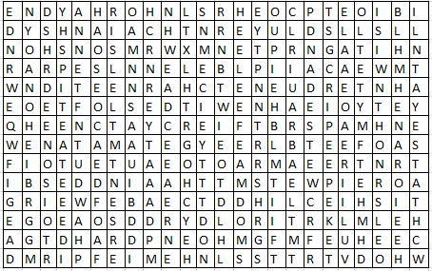
Rearranging K3 (Step 1)
First, put K3 into a 24 by 14 grid:

Slide 27
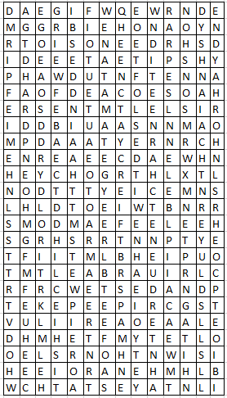
Rearranging K3 (Step 2)
Then, rotate it clockwise 90 degrees:

Slide 28
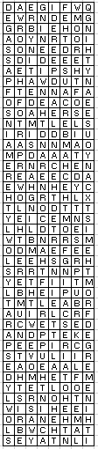
Rearranging K3 (Step 3)
Reformat the result into an 8 by grid:

Slide 29
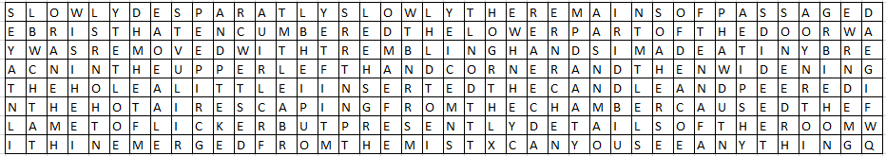
Rearranging K3 (Step 4)
Finally, rotate the grid 90 degrees CW again:

Slide 30
K3 Solution
SLOWLY DESPARATLY SLOWLY THE REMAINS OF PASSAGE DEBRIS THAT ENCUMBERED THE LOWER PART OF THE DOORWAY WAS REMOVED WITH TREMBLING HANDS I MADE A TINY BREACH IN THE UPPER LEFT HAND CORNER AND THEN WIDENING THE HOLE A LITTLE I INSERTED THE CANDLE AND PEERED IN THE HOT AIR ESCAPING FROM THE CHAMBER CAUSED THE FLAME TO FLICKER BUT PRESENTLY DETAILS OF THE ROOM WITHIN EMERGED FROM THE MIST X CAN YOU SEE ANYTHING Q ?

Slide 31
More About K3
This plaintext is a description of what happened when King Tut’s tomb was opened in 1922, according to Howard Carter’s book “The Tomb of Tutankhamun”. Lord Carnarvon asked Carter if he saw anything peering into the tomb, and “Q” (Carter) famously responded, “wonderful things”!
Note the misspelling of “DESPARATLY”

Slide 32
“How Did They Find The Solution?”
Supposedly, NSA cryptographer Dennis McDaniels discovered the rotation in six hours by just sitting on his couch and looking at it
He said he noticed a “Q” in the encrypted text and tried to manipulate the columns until a “U” appeared next to the “Q”
(However, that story can’t be correct since there is on QU in the plaintext!)

Slide 33
How To Solve K4
Nobody has solved K4 as of today (January 2017)
Jim Sanborn was getting flooded with so many questions (and incorrect answers) that he implemented a website that would automatically check submissions at: http://www.kryptosclue.com
However, as of 2017, that website is down and not functioning. You can supposedly test your answer by submitting $50 money order to Sanborn at: kryptos@earthlink.net
Perhaps Sanborn is getting sick of the whole thing

Slide 34
Is K4 A Simple Transposition?
Maybe K4 uses the same encryption method as K3, the way K1 and K2 are both Vigenère?
However, this is doubtful
  In English, the most frequently-used letters are:
  ETAOINSHRDLU…
  However, for this message the most frequent are:
  K/STU/BO/AFGILQRWZ…
So, K4 is probably not a single transposition

Slide 35

Is K4 A Simple Vigenère?
In 2006, Jim Sanborn gave a clue:
The 64-69 letters in K4 are CLOCK
And in 2014, he gave another clue:
The 70-74 letters are BERLIN
No one knows what a “BERLINCLOCK” is

Slide 36
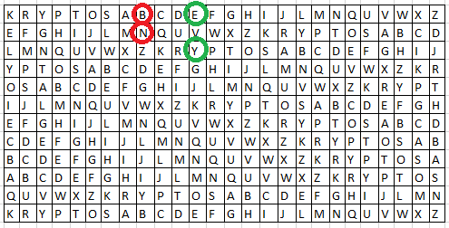

Vigenère With BERLINCLOCK
If we have the encrypted text and we know the solution plaintext, we can find the keyword!
Meaning the keyword would be ELYOIECBAQK, which makes no sense and can’t be right

Slide 37
Transposition AND A Vigenère
My guess is that Sanborn used a transposition first (as in K3), and then did a substitution Vigenère (as in K1 and K2)
Cracking a single Vigenère substitution is difficult. Decrypting a message that has used two (or more!) substitutions would be much worse. I am hoping that is not the case

Slide 38


Possible Method Of K4
Take a message
Create an interesting way of mixing it up
Perform a Vigenère, using a keyword (like “SWAN”)

Slide 39
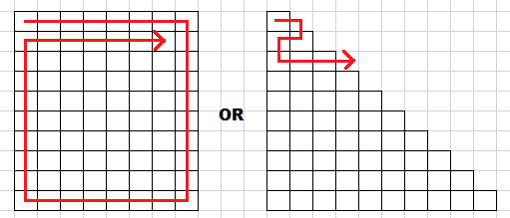
Methods Of Transformation
Jim Sanborn is an artist. As such, he may have invented a new type of route or path transformation that looked “nice” to him
Until the answer is discovered, we will not know

Slide 40
97 Is Prime
Unfortunately, 97 is a prime number. So, it can’t be factored in the many ways that K3 could (at 336 = 24 x 14 characters)
K4 can’t be arranged geometrically easily
1+2+3+4+5+6+7+8+9+10+11+12+13=91
1+3+5+7+9+11+13+15+17=81
1+2+3+4+5+6+7+8+9+8+7+6+5+4+3+2+1=81
1+3+5+7+9+11+13+11+9+7+5+3+1=85

Slide 41
Random Transformation
So, my idea is to:
  Perform a random permutation on the 97 characters
  Use the BERLINCLOCK crib to find eleven letters that may be part of a keyword
  Use a dictionary lookup to see if any English word partially matches the keyword
For example a partial decryption of BERLINCLOCK = KESLEAVIZLE might hint at a repeated keyword LEAVESLEAVESLEAVES

Slide 42

Example Of Method
So, imagine that after shuffling all 97 letters of the encrypted text randomly, the 64th through 74th letters happen to be: BVABKKOSTKE
Then, do a reverse “Sanborn’s Vigenère” to find eleven keyword letters of KESLEAVIZLE
A dictionary lookup suggests the keyword is LEAVES (repeated as LEAVESLEAVESLEAVES)

Slide 43
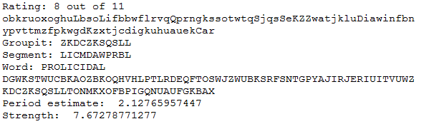
Python Code
An implementation in Python can be found at: https://github.com/patrickkellogg/Kryptos
Currently, the output states:
  How many of the 11 letters match the keyword
  The original encrypted 97 characters with the 11 chosen “crib” characters in UPPER CASE

Slide 44
Code Results
  “Groupit”, the 11 randomly shuffled encrypted letters that make up the BERLINCLOCK crib
  “Segment”, the 11 possible keyword letters
  The keyword chosen from a dictionary lookup
  The fully decrypted string using the keyword
  And finally, a FFT (described on next page)

Slide 45

Fast Fourier Transform (FFT)
If I have a good keyword candidate, I can see the locations of where chosen 11 crib letters came from
In this example, every third letter seems to be randomly chosen to be part of the 11 letters
This is turned into a Python array like this:
[0,0,1,0,0,1,0,0,1,0,0,1,0,0,1…

Slide 46
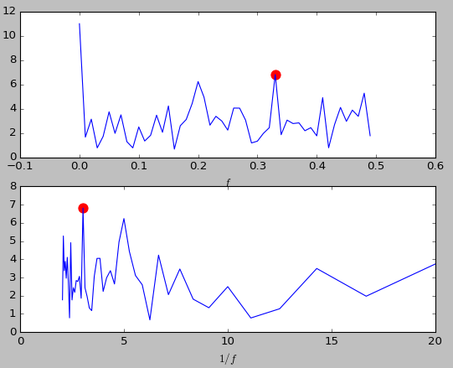
FFT Period Estimate
Once I have a Python array of ones and zeros, I do a FFT on the data, and plot the results

Slide 47
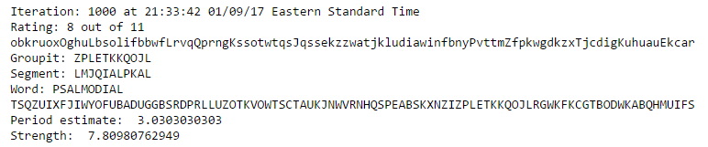
FFT Strength
Or, I could have done an autocorrelation. Both methods find repetitions in the data
This keyword PSALMODIAL only has a Strength of 7.8, where better candidates are closer to 10. This keyword is probably not correct

Slide 48

More On The FFT
I can also find the “peak” of the largest possible frequency component. For example,
might suggest a “folding” of every third letter
This would be helpful in the future to try and figure out if and how Sanborn is perform a transformation.

Slide 49
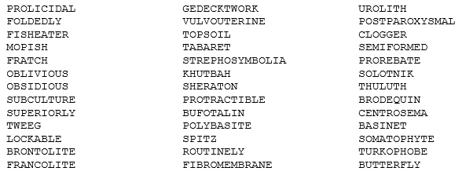
My Word List
Here are some possible keywords that my code has found:

Slide 50
Other Kryptos Errors
There are several other strange things about the Kryptos sculpture:
  The Vigenère table on sculpture (which, as stated, earlier, is not even used correctly by Sanborn for the encryption) has a bad line on the top line of the bottom-right quadrant “NGHIJL…” with one too many “L” characters at the end
For some reason, in the bottom-left quadrant, three of the first few letters are raised above the others (the “YA R” in ENDYAHR)
Some people have thought K4 contains an error and that’s why it’s difficult to crack, but in 2003 Sanborn said, “Yes. It ain't easy, but it's solvable!“

Slide 51
Quotes by Sanborn (Part 1)
“The last 97 characters? Don't hold your breath… I saved the best for last.”
“In a modern digital system, the 'key' is the keyword or number that you need to decrypt the message. Everyone knows the algorithm. It is just a black box into which you insert the key and the encrypted text, and the answer comes out the other end. In analog systems (as used in Kryptos) the 'key' is the algorithm.”

Slide 52
Quotes by Sanborn (Part 2)
“I used a bit of stego (steganography) when designing the fourth part of Kryptos.”
“In the first 3 parts, I gave anyone attempting to break the code the advantage of the English language with all its known patters(sic), but I removed that advantage in the fourth part.”
“I don't presume to think that ‘Kryptos’ sculpture has the import that finding Tutankhamen's tomb would have, but it's that same magic of finding something, finding a fossil or finding an Indian arrow head or something like that. It's magical, because it's something that was made in the past. So I wanted to somehow demonstrate that magic, for everyone, once it was cracked."

Slide 53
Timeline
1988 Kryptos is commissioned by the CIA Fine Arts Commission
1990 Sculpture is installed at Langley, VA
2010 Sanborn gives out the crib “BERLIN”
2014 To honor the 25th anniversary of the fall of the Berlin Wall, the word “CLOCK” crib was given as a second crib

Slide 54
Ongoing Work
Supposedly, the NSA stopped working on decrypting K4 because the small number of letters (97) were not enough to find an answer
There has been a notable decrease of interest in the sculpture, and several websites have stopped updating progress and theories
Even Jim Sanborn’s own website no longer exists

Slide 55
My Future Work
Refactor code so it can run faster, possibly even allowing multi-processors
With a long list of strong keyword candidates, try to find possible methods Sanborn used for transformation. For example, if many keywords have period ≈ 3, then Sanborn probably used a grid of length or width of three (or a multiple of three)
Look at alternative methods of rotation for K3

Slide 56
Resources
http://www.elonka.com/kryptos
  Elonka Dunin’s Kryptos page. Probably the best collection of information on Kryptos available
http://austininc.com/SciRealm/Kryptos.html
  The webpage of John B. Wilson, a physicist and mathematician from North Carolina
https://www.wired.com/2014/11/second-kryptos-clue/
  Good article from “Wired” magazine from 2014
https://en.wikipedia.org/wiki/Kryptos
  Wikipedia, of course

